Slide 1
Analysis Of Gas Sensor Array Under Dynamic
Gas Mixtures
Vaibhav Dnyandeo Ingale (016131167)
Lalitha Ramya Vemuri (016697317)
Hardwin Bui (011007156)
Notes:
Hardwin

Slide 2
Introduction
Chemical sensors are used in a wide variety of applications, including environmental monitoring, industrial process control, and medical diagnostics
To ensure their accuracy and performance, it is important to be able to predict the concentration of the gas that they are sensing
Notes:
Hardwin

Slide 3
Dataset Overview
UCI Machine Learning repository. This data provides Ethylene concentration level readings of 16 different sensors in 2 different chemical environments.
This data set consists of 4178504 instances and 19 attributes.
Notes:
Hardwin

Slide 4
Project Goal
Develop a data mining system that can be used to identify patterns in chemical sensor time series data
Classify and predict the concentration of different gasses in the air with high accuracy
Notes:
Hardwin

Slide 5
Algorithms to Consider
Logistic Regression
An extension of linear regression that can be used to predict qualitative response for an observation
LDA & QDA
Can provide accuracy score, classification report, and confusion matrix for the dataset
K-Fold
Cross-validation can help evaluate the performance of the model
PCA
Can be used to reduce the dimensionality of the data and capture the most important features
Notes:
Hardwin

Slide 6
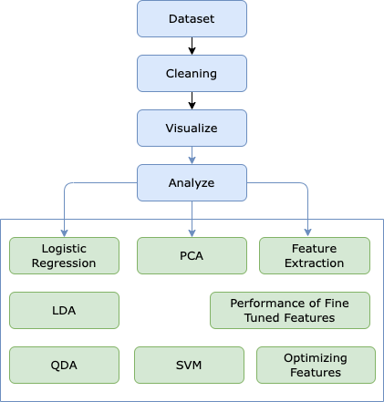
Process Flowchart
Notes:
Hardwin

Slide 7
Importance of Sensors
Industrial Safety
help prevent accidents caused by gas leaks and ensure the safety of workers
Agriculture
monitor the levels of ethylene gas in greenhouses, which is naturally produced by ripening fruits and vegetables
Environmental Monitoring
detect and monitor the levels of methane gas emissions in landfills and wastewater treatment facilities
Food Quality Control
detect the presence of ethylene gas in food storage and transportation environments
Medical Application
detect the presence of certain gasses in a patient's breath, which can be used to diagnose various medical conditions
Notes:
Hardwin

Slide 8
Project Methodology
EDA/Preprocessing
Feature Selection
Model Selection
Model Training
Testing and Evaluation
Remove missing values and normalize sensor readings
Reduce dimensionality of data and select most important features that contribute to detection of Ethylene and Methane.
- Logistic Regression (LR)
- Linear Discriminant Analysis (LDA) - Quadratic Discriminant Analysis (QDA) - KNN - SVM
For LDA, QDA, and LR, data is split into half for training and half for testing and accuracy is calculated using testing data.
For all models used,
accuracy was obtained by comparing predicted labels to true labels.
Notes:
Lalitha

Slide 9
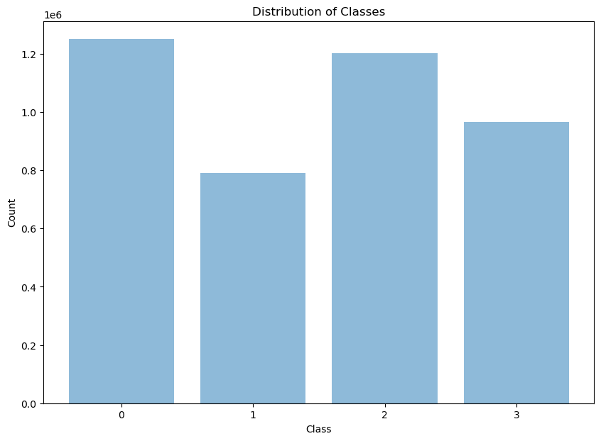
Distribution of classes
Class | Ethylene | Methane
0 | 0 | 0
1 | 1 | 0
2 | 0 | 1
3 | 1 | 1
Notes:
Vaibhav

Slide 10
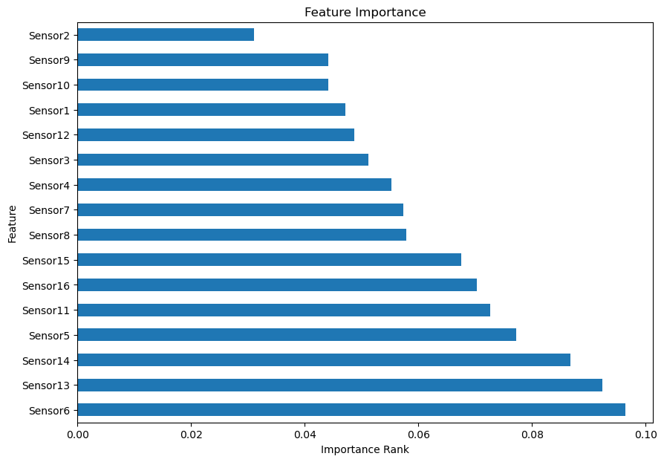
Feature Importance
We used inbuilt class feature_importances of tree based classifiers - ExtraTreesClassifier By knowing which features are the most important, we can focus our attention on those features and potentially discard less important ones, which can reduce the dimensionality of the dataset and improve the performance.
Notes:
Vaibhav

Slide 11
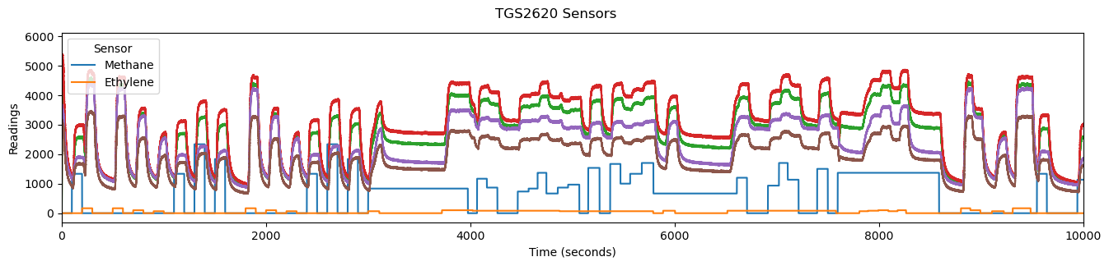
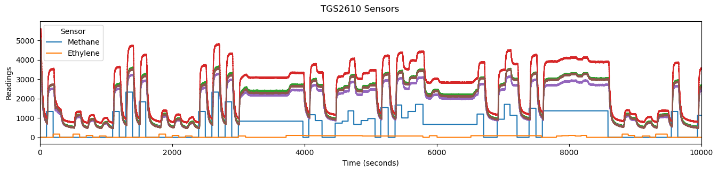
Sensor Readings vs Concentrations
Notes:
Vaibhav

Slide 12
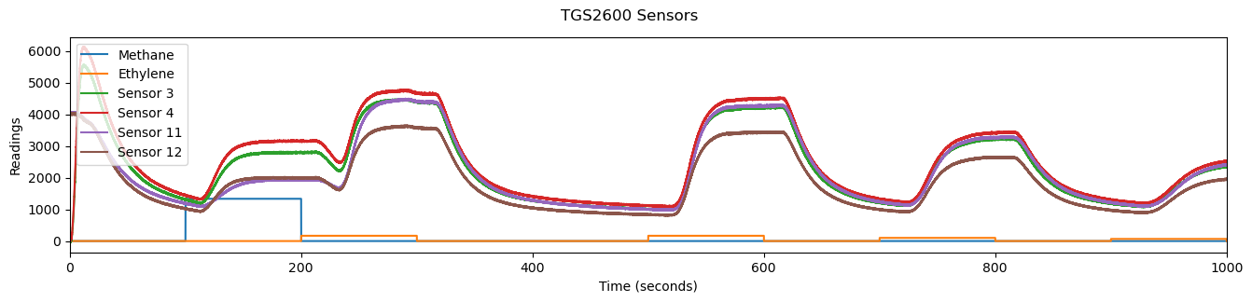
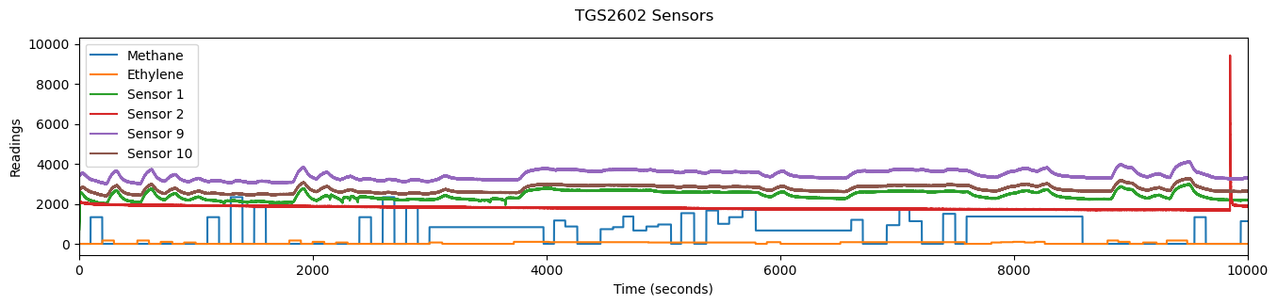
Sensor Readings vs Concentrations
Notes:
Vaibhav

Slide 13
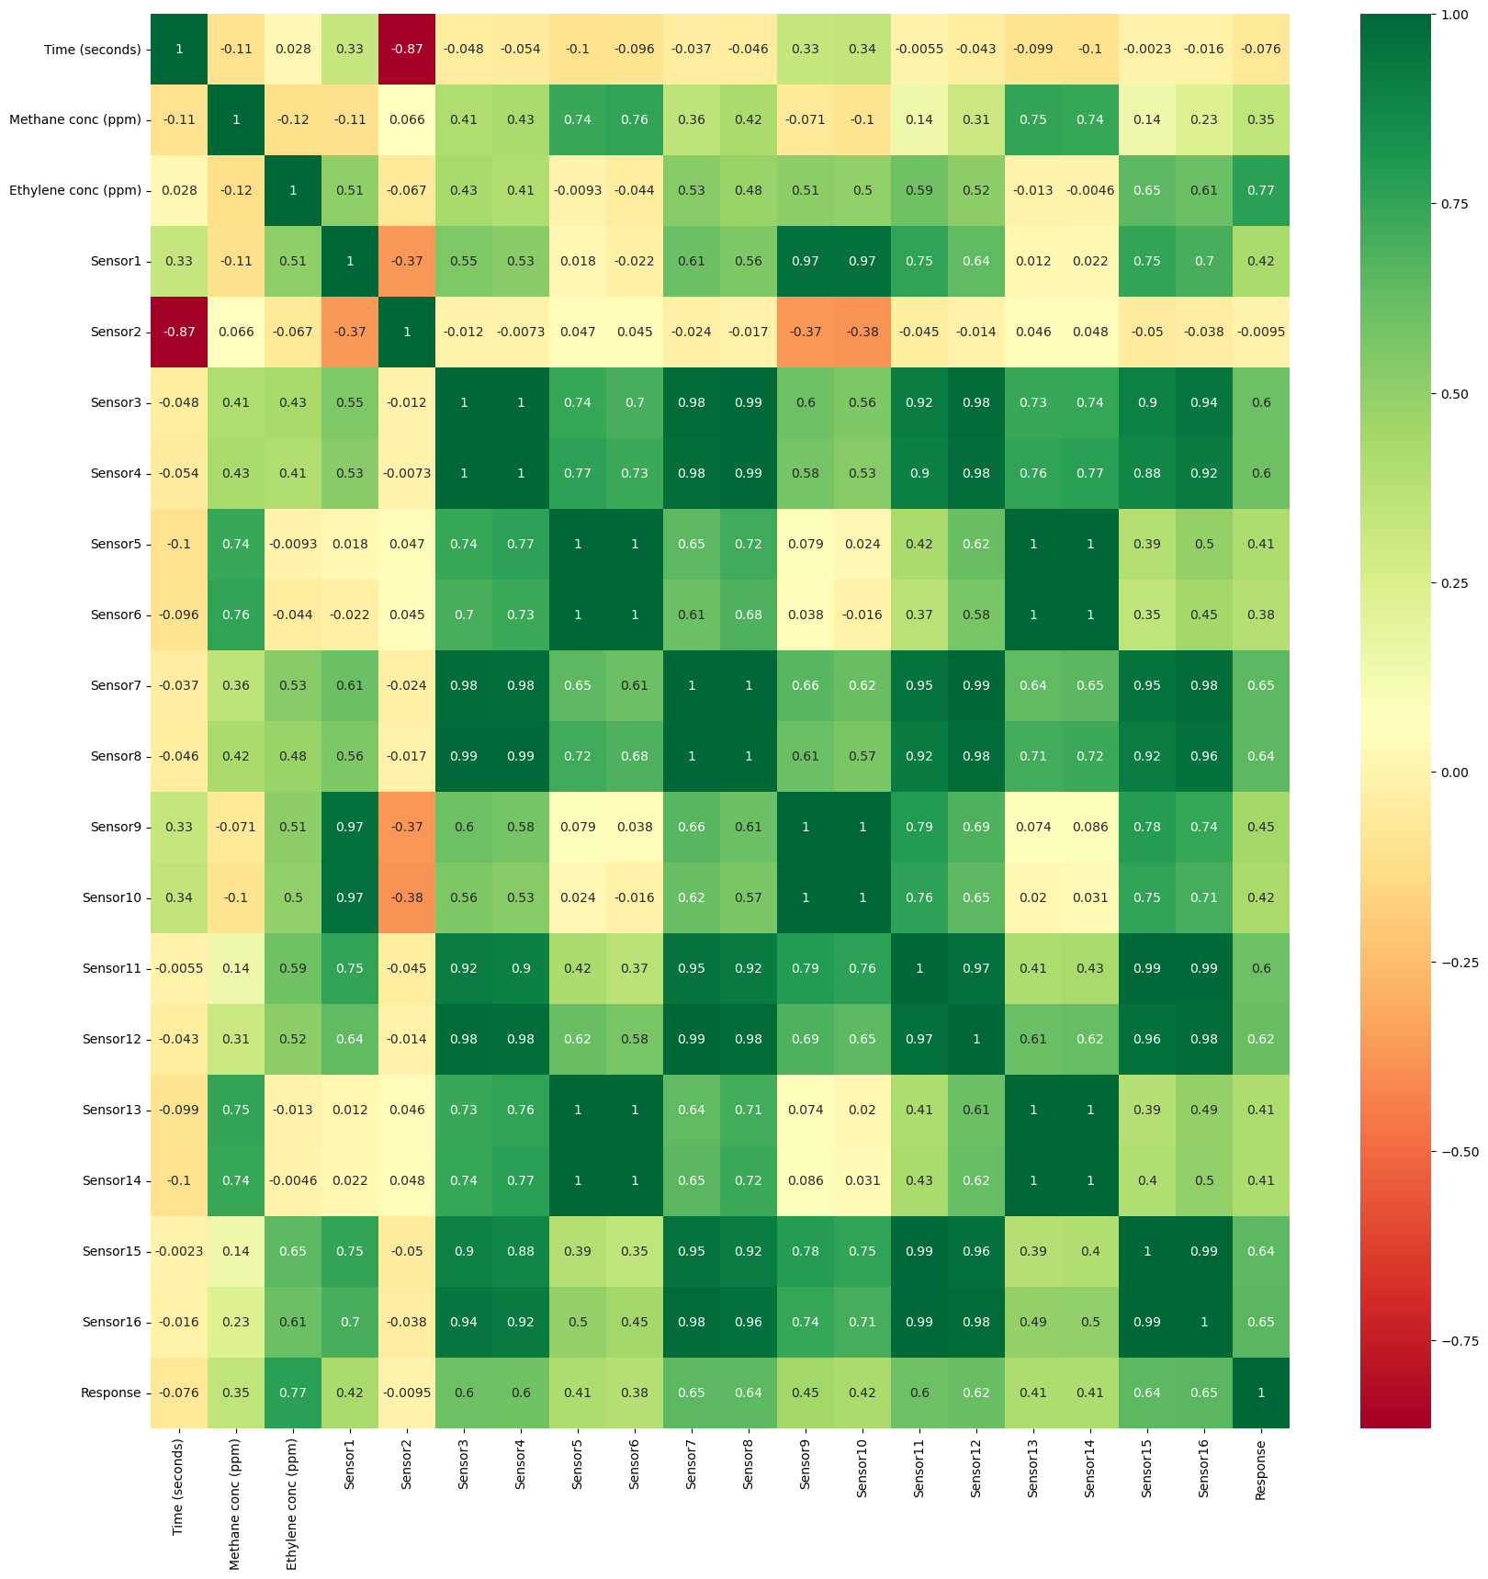
Correlation Matrix Heat Map
Sensor 2 Readings
Notes:
Vaibhav

Slide 14
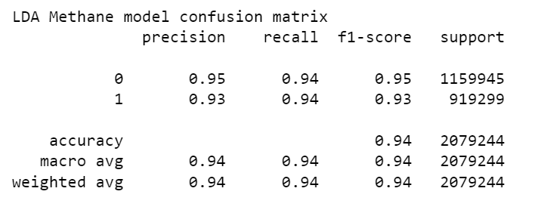
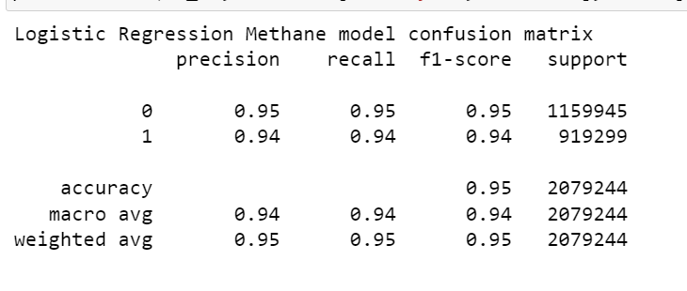
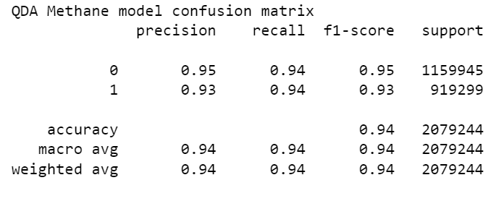
Classification Reports
Notes:
Lalitha

Slide 15
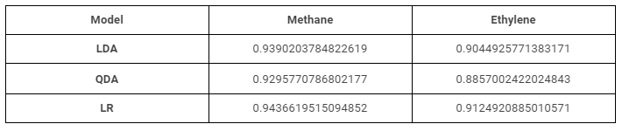
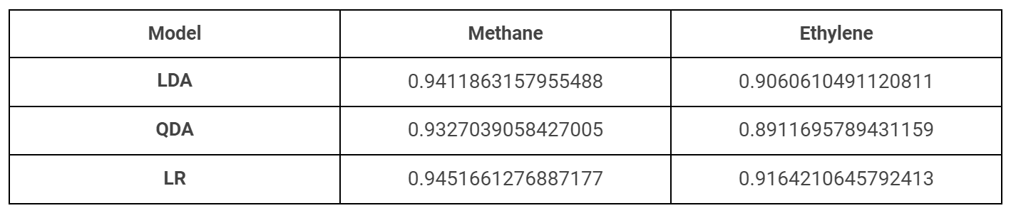
Analysis of results
Accuracy After Preprocessing:
Performance of fine-tuned features
Notes:
Lalitha

Slide 16
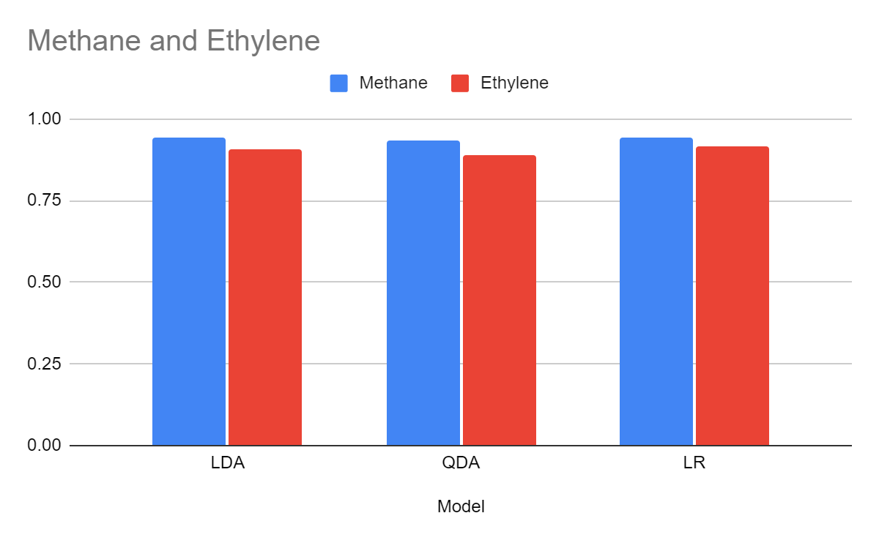
Analysis of results
Notes:
Lalitha

Slide 17
Conclusion
In conclusion, we analyzed gas mixtures using an array of sensors and compared the performance of three classification models: logistic regression, LDA, and QDA.
After evaluating the results, we found that all three models performed well, but logistic regression was the most effective in this case. It provided the highest accuracy rate, indicating that it was able to correctly classify gas mixtures with a higher degree of accuracy than the other models.
Overall, the use of an array of sensors and logistic regression can be a useful tool for accurately classifying gas mixtures, which can have a wide range of applications in various industries.
Notes:
Lalitha

